Slide 1
NE Figure Dump

Slide 2
Vessel Add Rates
New foreign WTIV/2 feeders can enter every 2 years
New AHTS can enter every 2 years
New FFIV can enter every 2 years
FFIV fleet matched to WTIV fleet

Slide 3
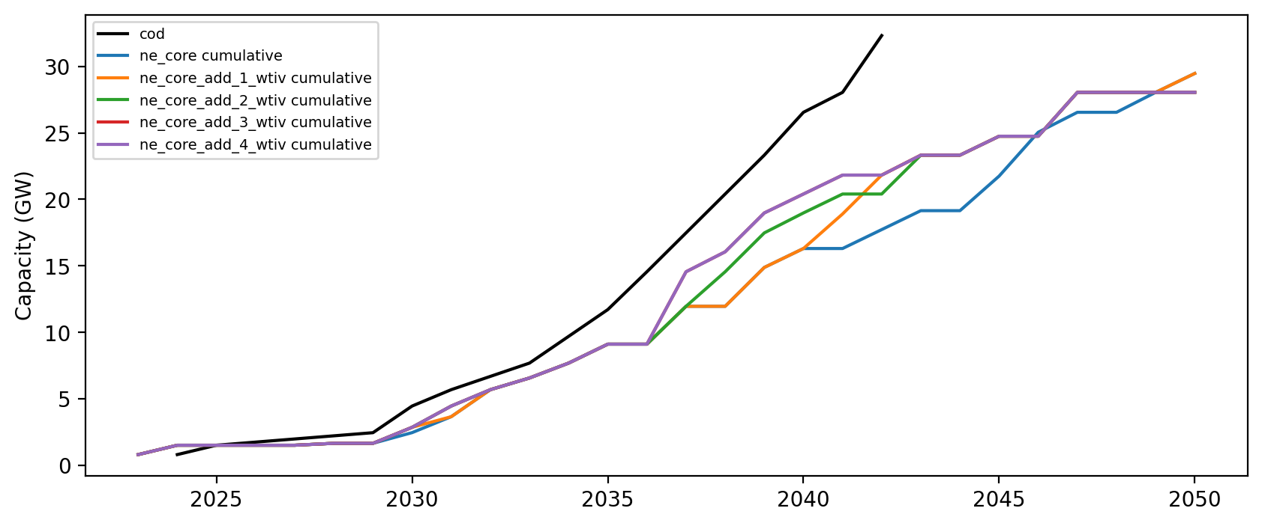
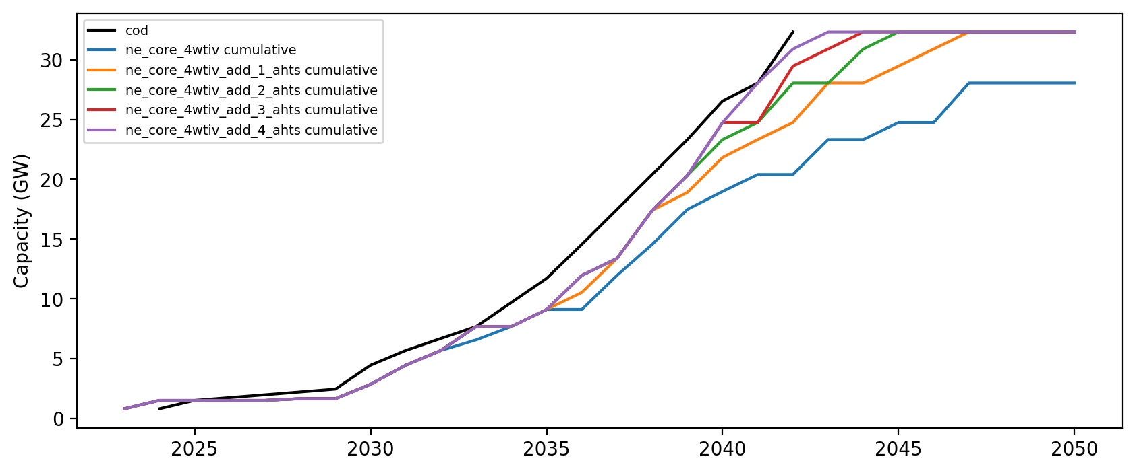
Core
4 WTIV
5 AHTS
8 feeder
5 FFIV

Slide 4
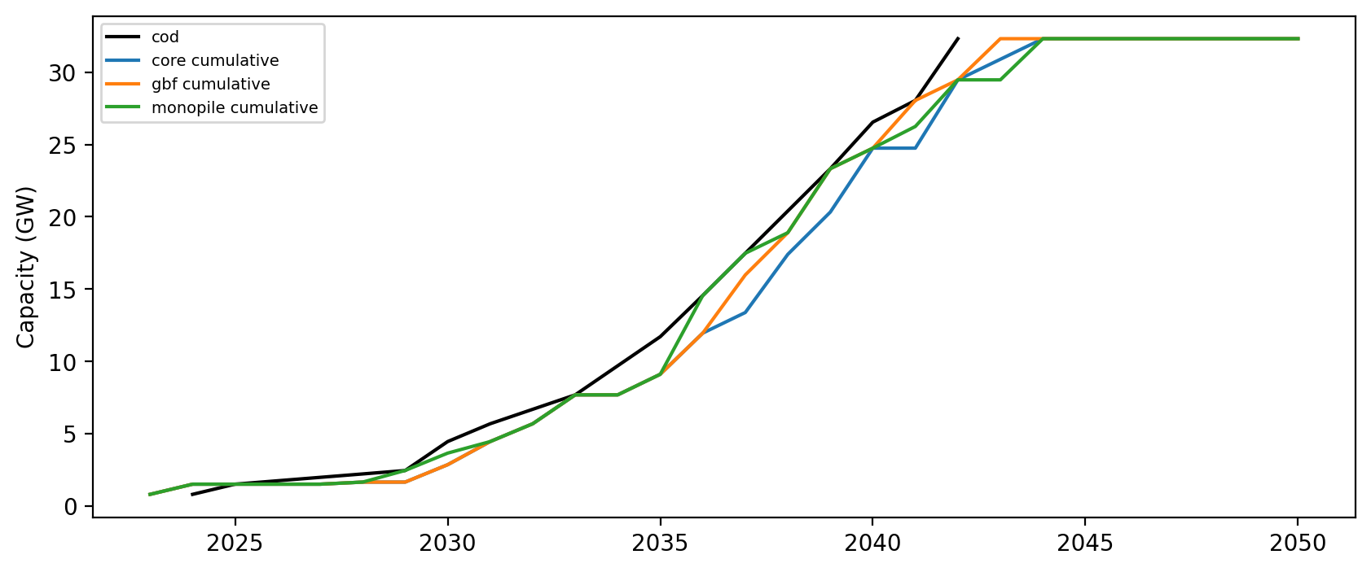
Foundations

Slide 5
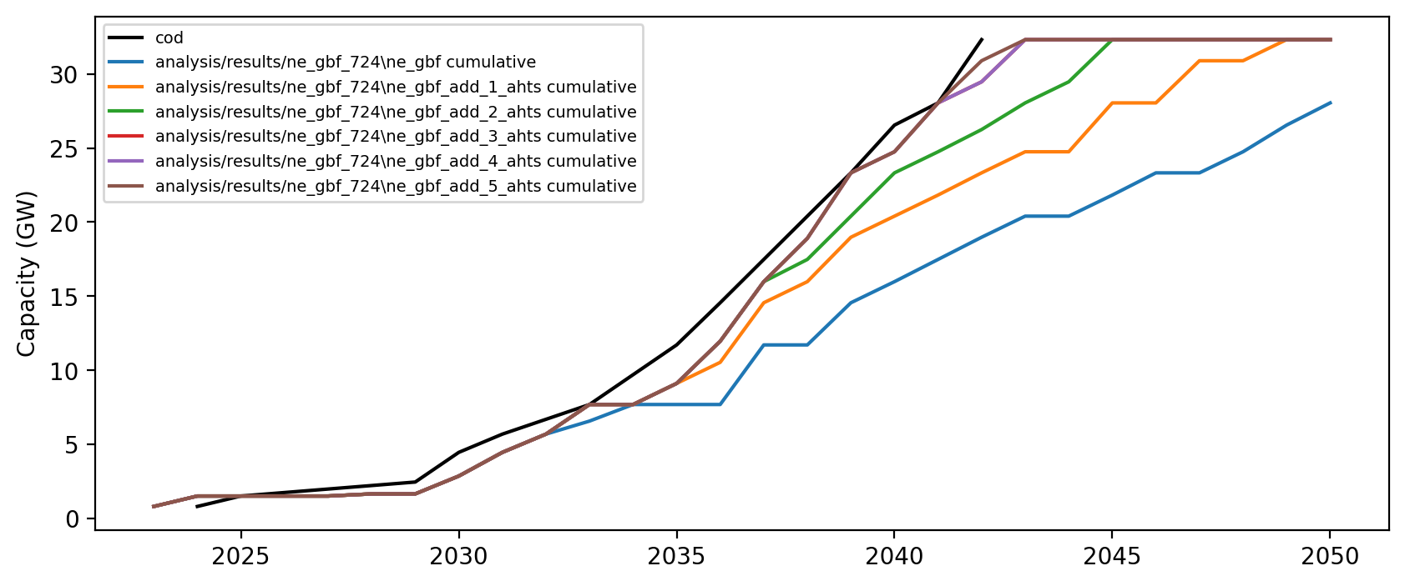
GBF
6 AHTS
2 WTIV
2 FFIV
4 feeder

Slide 6
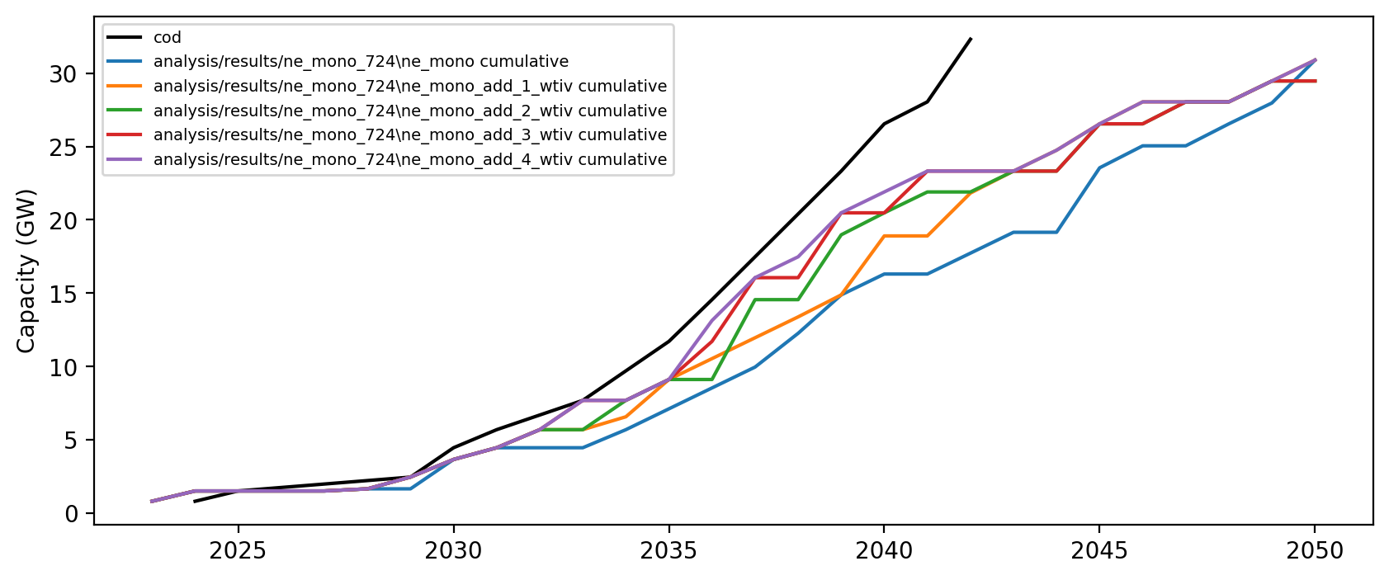
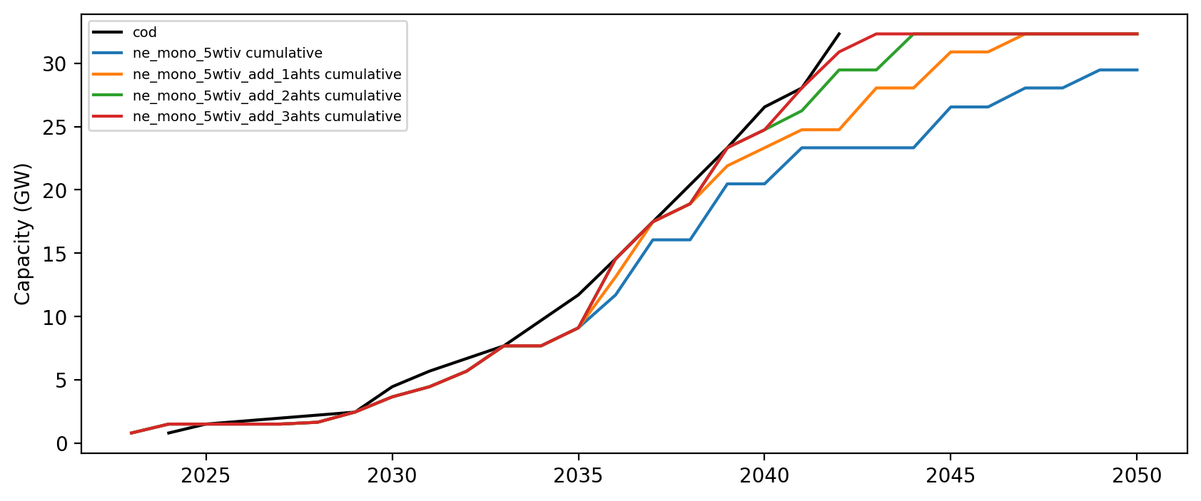
Monopile
5 WTIV
10 feeder
6 FFIV
4 AHTS

Slide 7
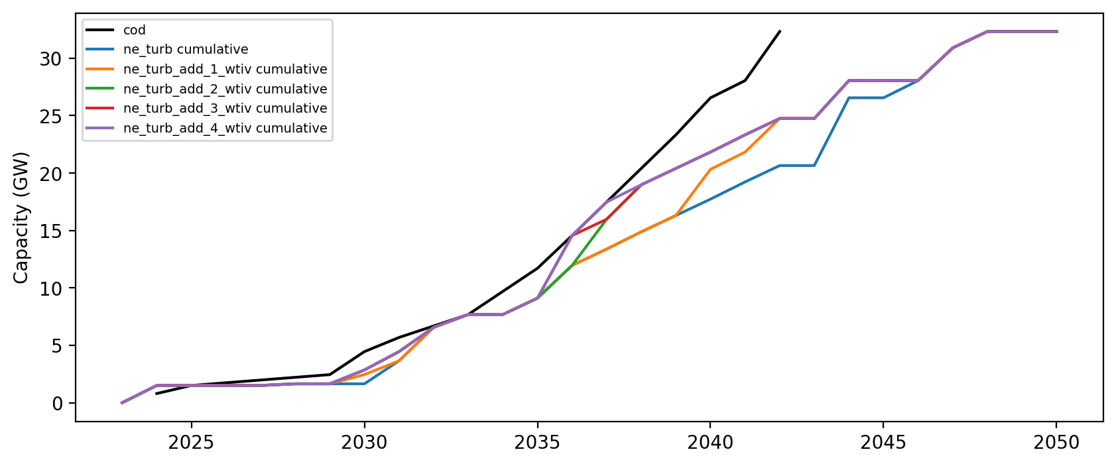
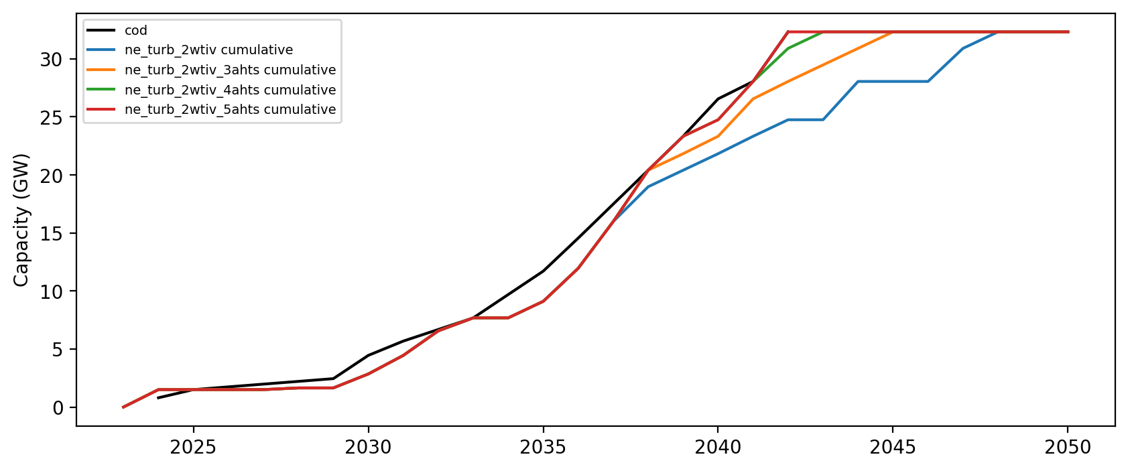
Turbine Upsizing
4 WTIV
8 feeder
5 FFIV
4 ahts

Slide 8
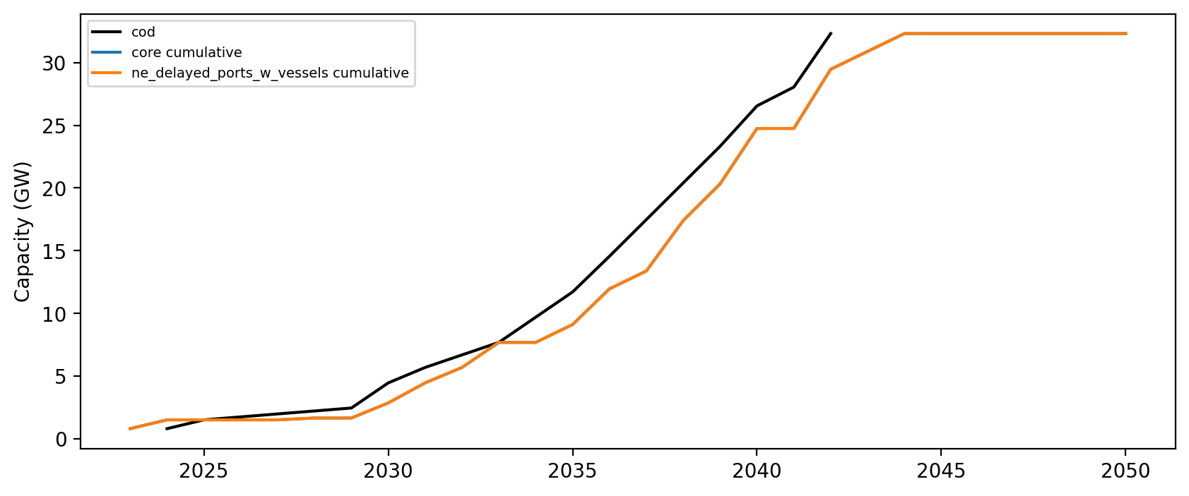
Delayed Ports
Same vessels as core
Delayed all NE ports not in the pipeline at start of sim by 3 yrs

Slide 9
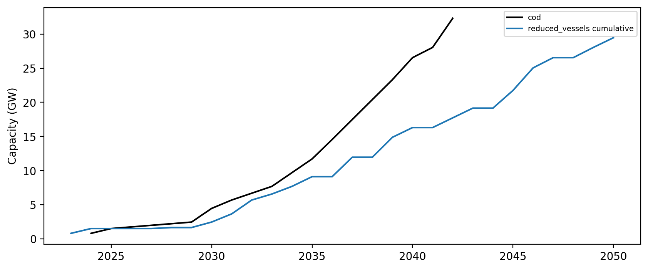
Reduced Vessels
2 WTIV
4 feeder
3 FFIV
2 AHTS
Based on vessel study

Slide 10
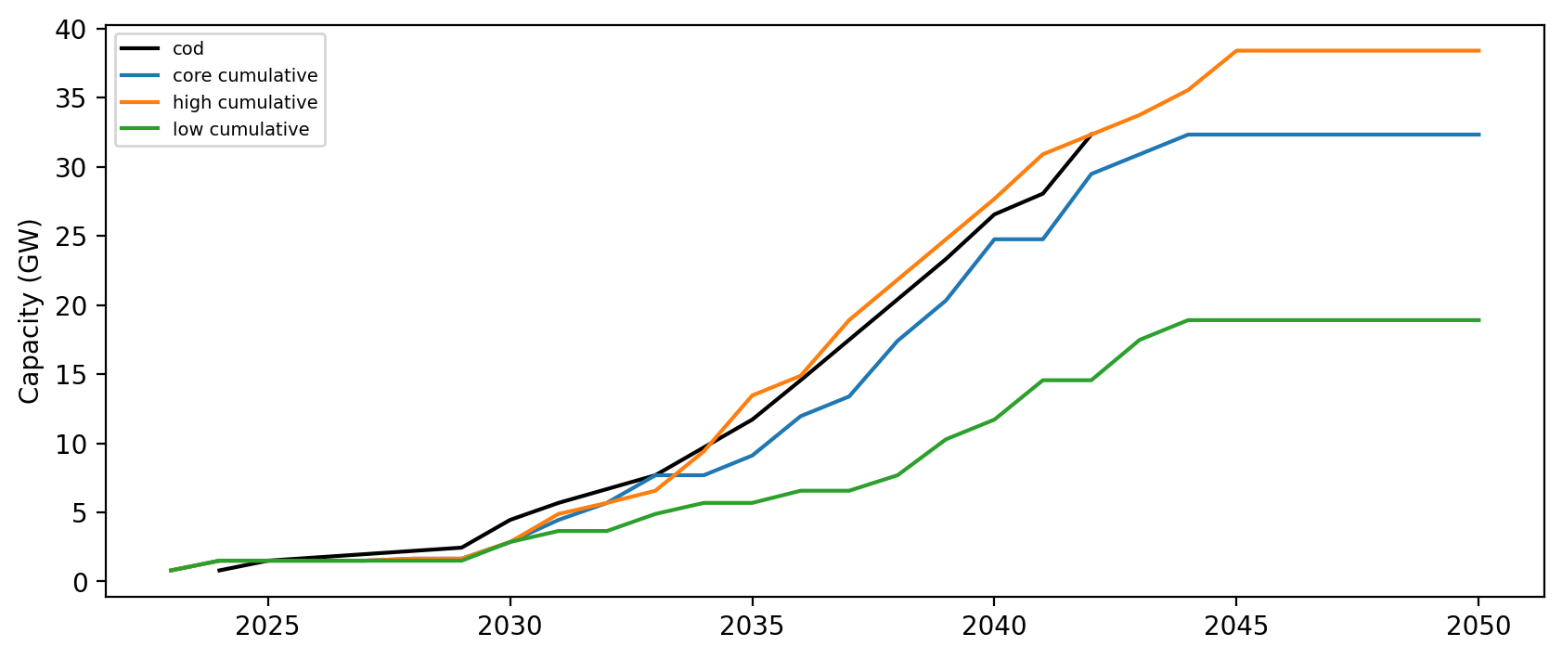
Alternate Deployment

Slide 11
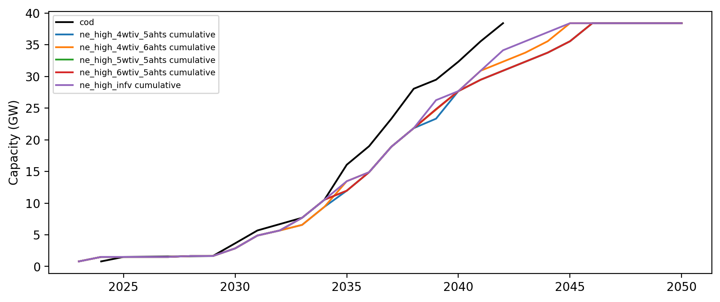
High
4 WTIV
8 Feeder
5 FFIV
6 AHTS

Slide 12
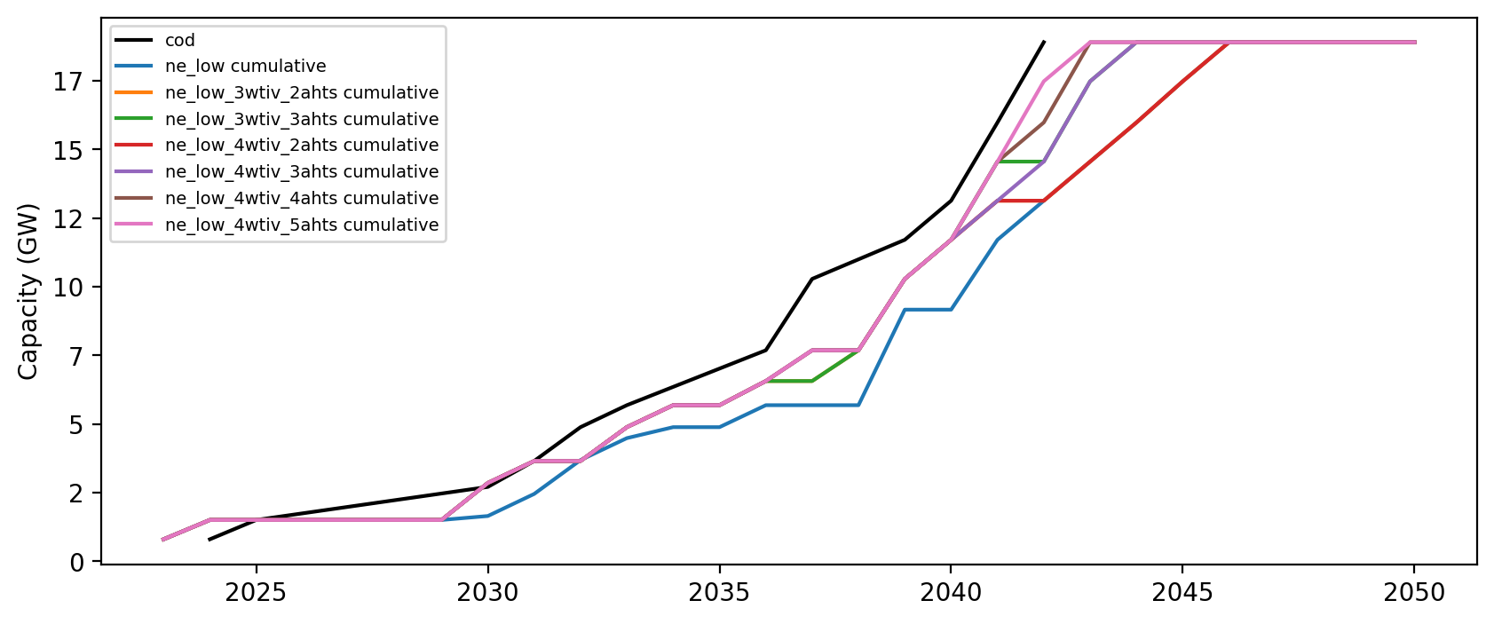
Low
3 WTIV
3 AHTS
6 Feeder
4 FFIV

Slide 13
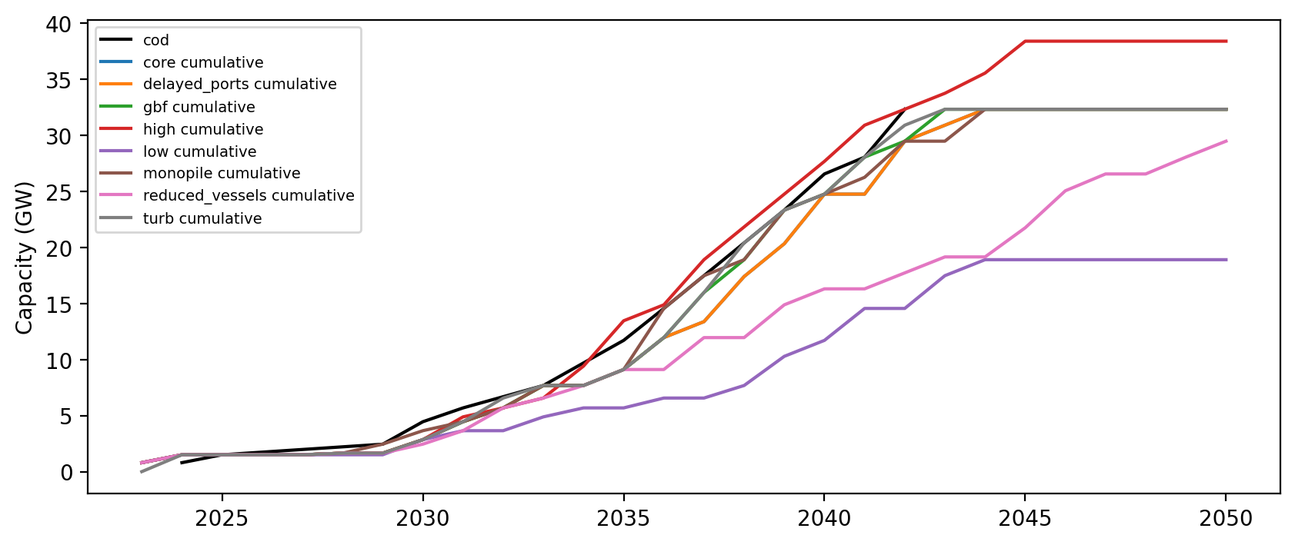
All Scenarios

